Slide 1
3D Computer Vision
Algorithmic approach
By,
Somnath Sendhil Kumar

Slide 2
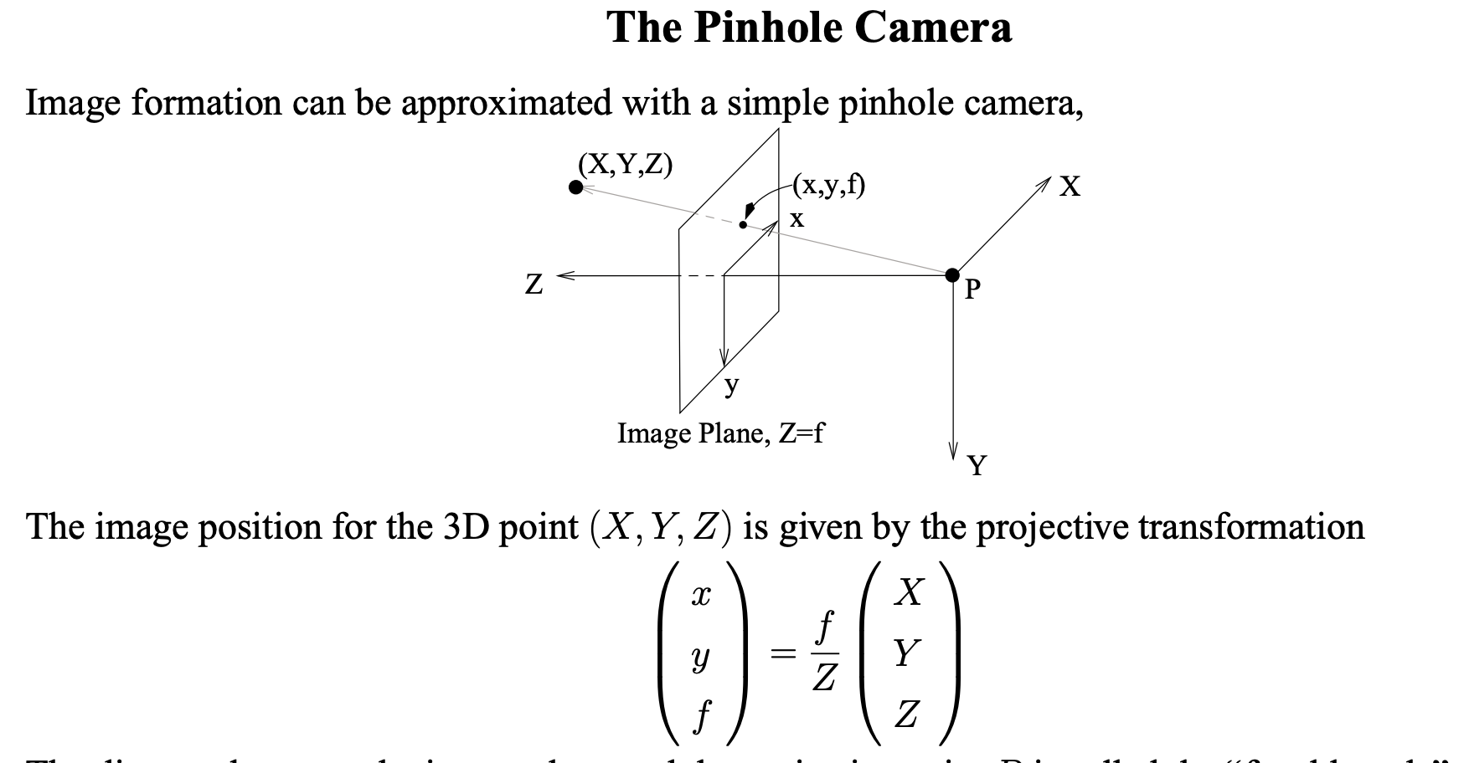
2D Frame representation of the World

Slide 3
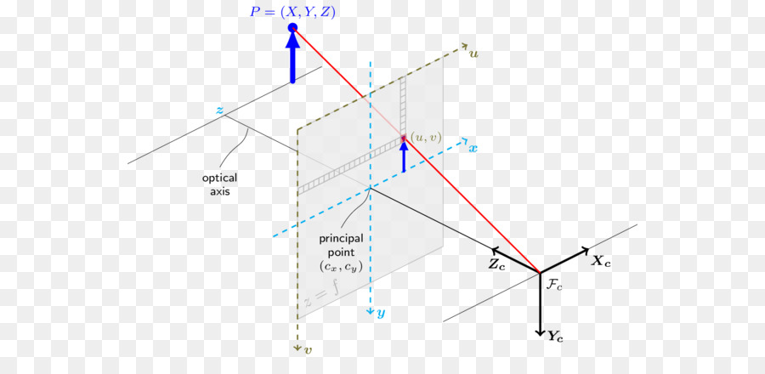
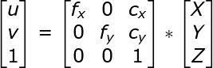
3D Projection on a frame

Slide 4
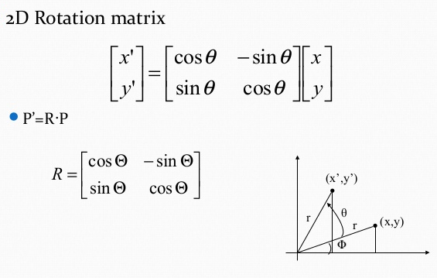
Motion of Bodies and there representation
This is the most basic transformation that we learn , mostly we used complex nos to make our life easier

Slide 5
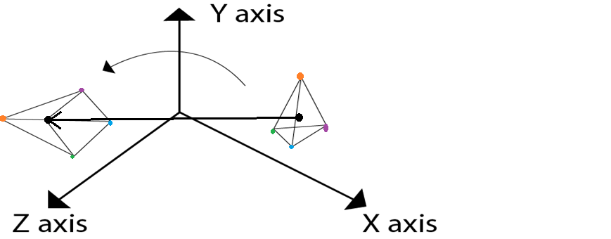
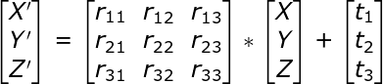
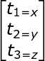
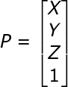
Motion of Bodies and there representation

Slide 6
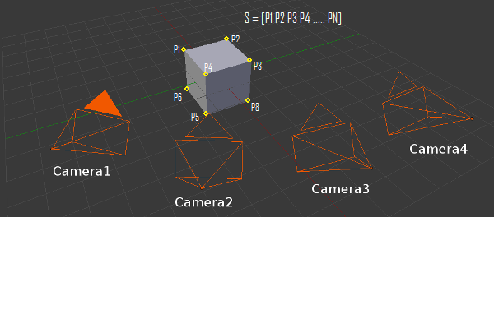
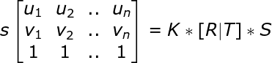
Summing up the two theories
Now you have a correlation between the real world coordinate systems and frame coordinates.

Slide 7

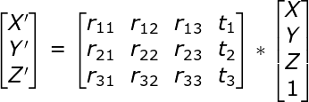
All the equation at once.
Camera Feed
constant
Arbitrary Constant making the calculation of inverse of any matrix difficult. Some Iterative approach exist to help us find a unique solution for any matrix in the system of equation, these iterative approach decrease losses which are based on photometric continuity.

Slide 8
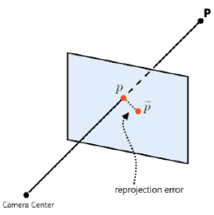
Reprojection Error
It's simply the difference in the actual point and the point we get using the inverse transform.
Many iterative approaches this as the objective to minimize ,
Few examples given in the opencv are solvePnP, solvePnPRansac, solveUPnP .

Slide 9
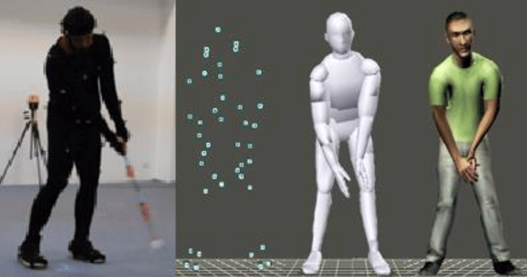
Implementations
To find orientation of object or position in the world coordinates. This can be used in various places like motion tracking or Pose estimation.

Slide 10
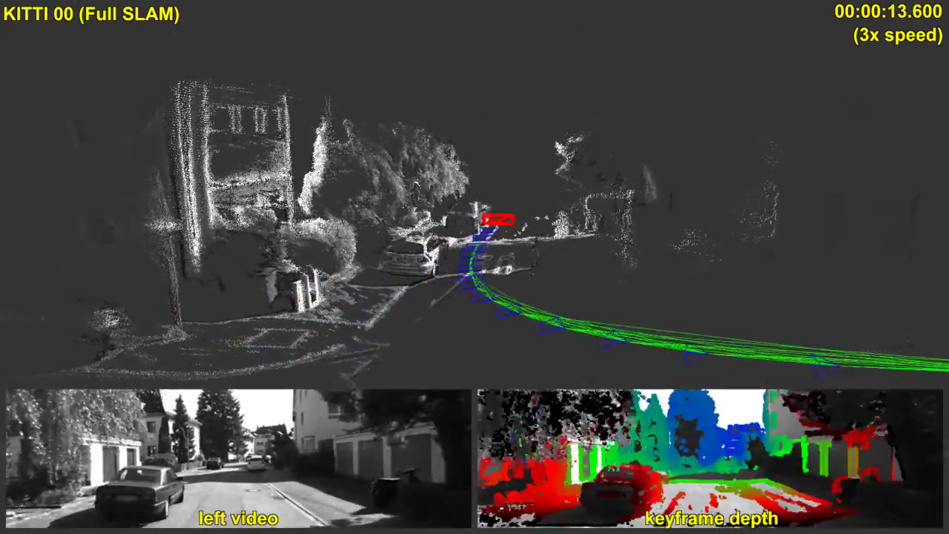
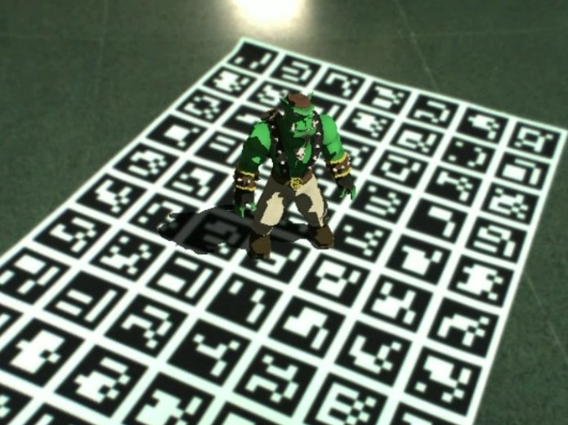
Implementations - AR & VR

Slide 11
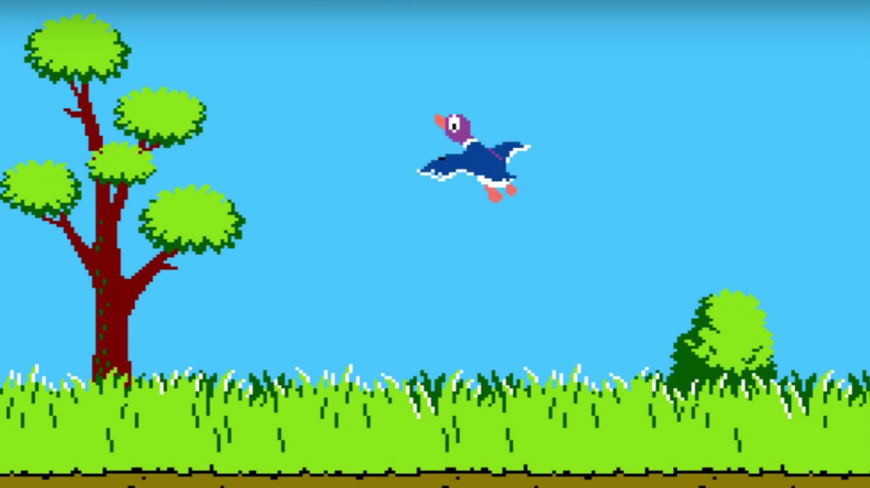
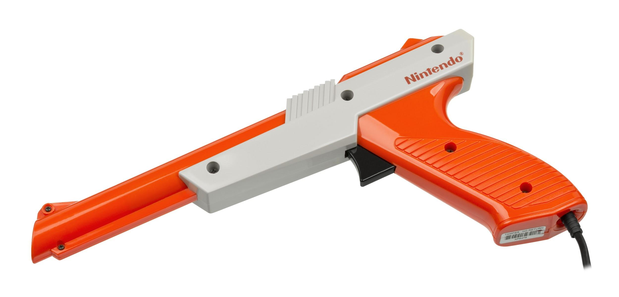
Implementations - Light-Gun
Nothing more satisfactory than hearing the shot and seeing the bird dead

Slide 12
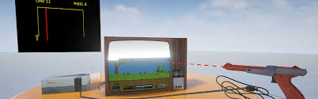
Implementations - Light-Gun
So CRT monitor runs several updates to process the image hence its easy to work out the x, y coordinate with respect to the starting pixel.
watch it!

Slide 13
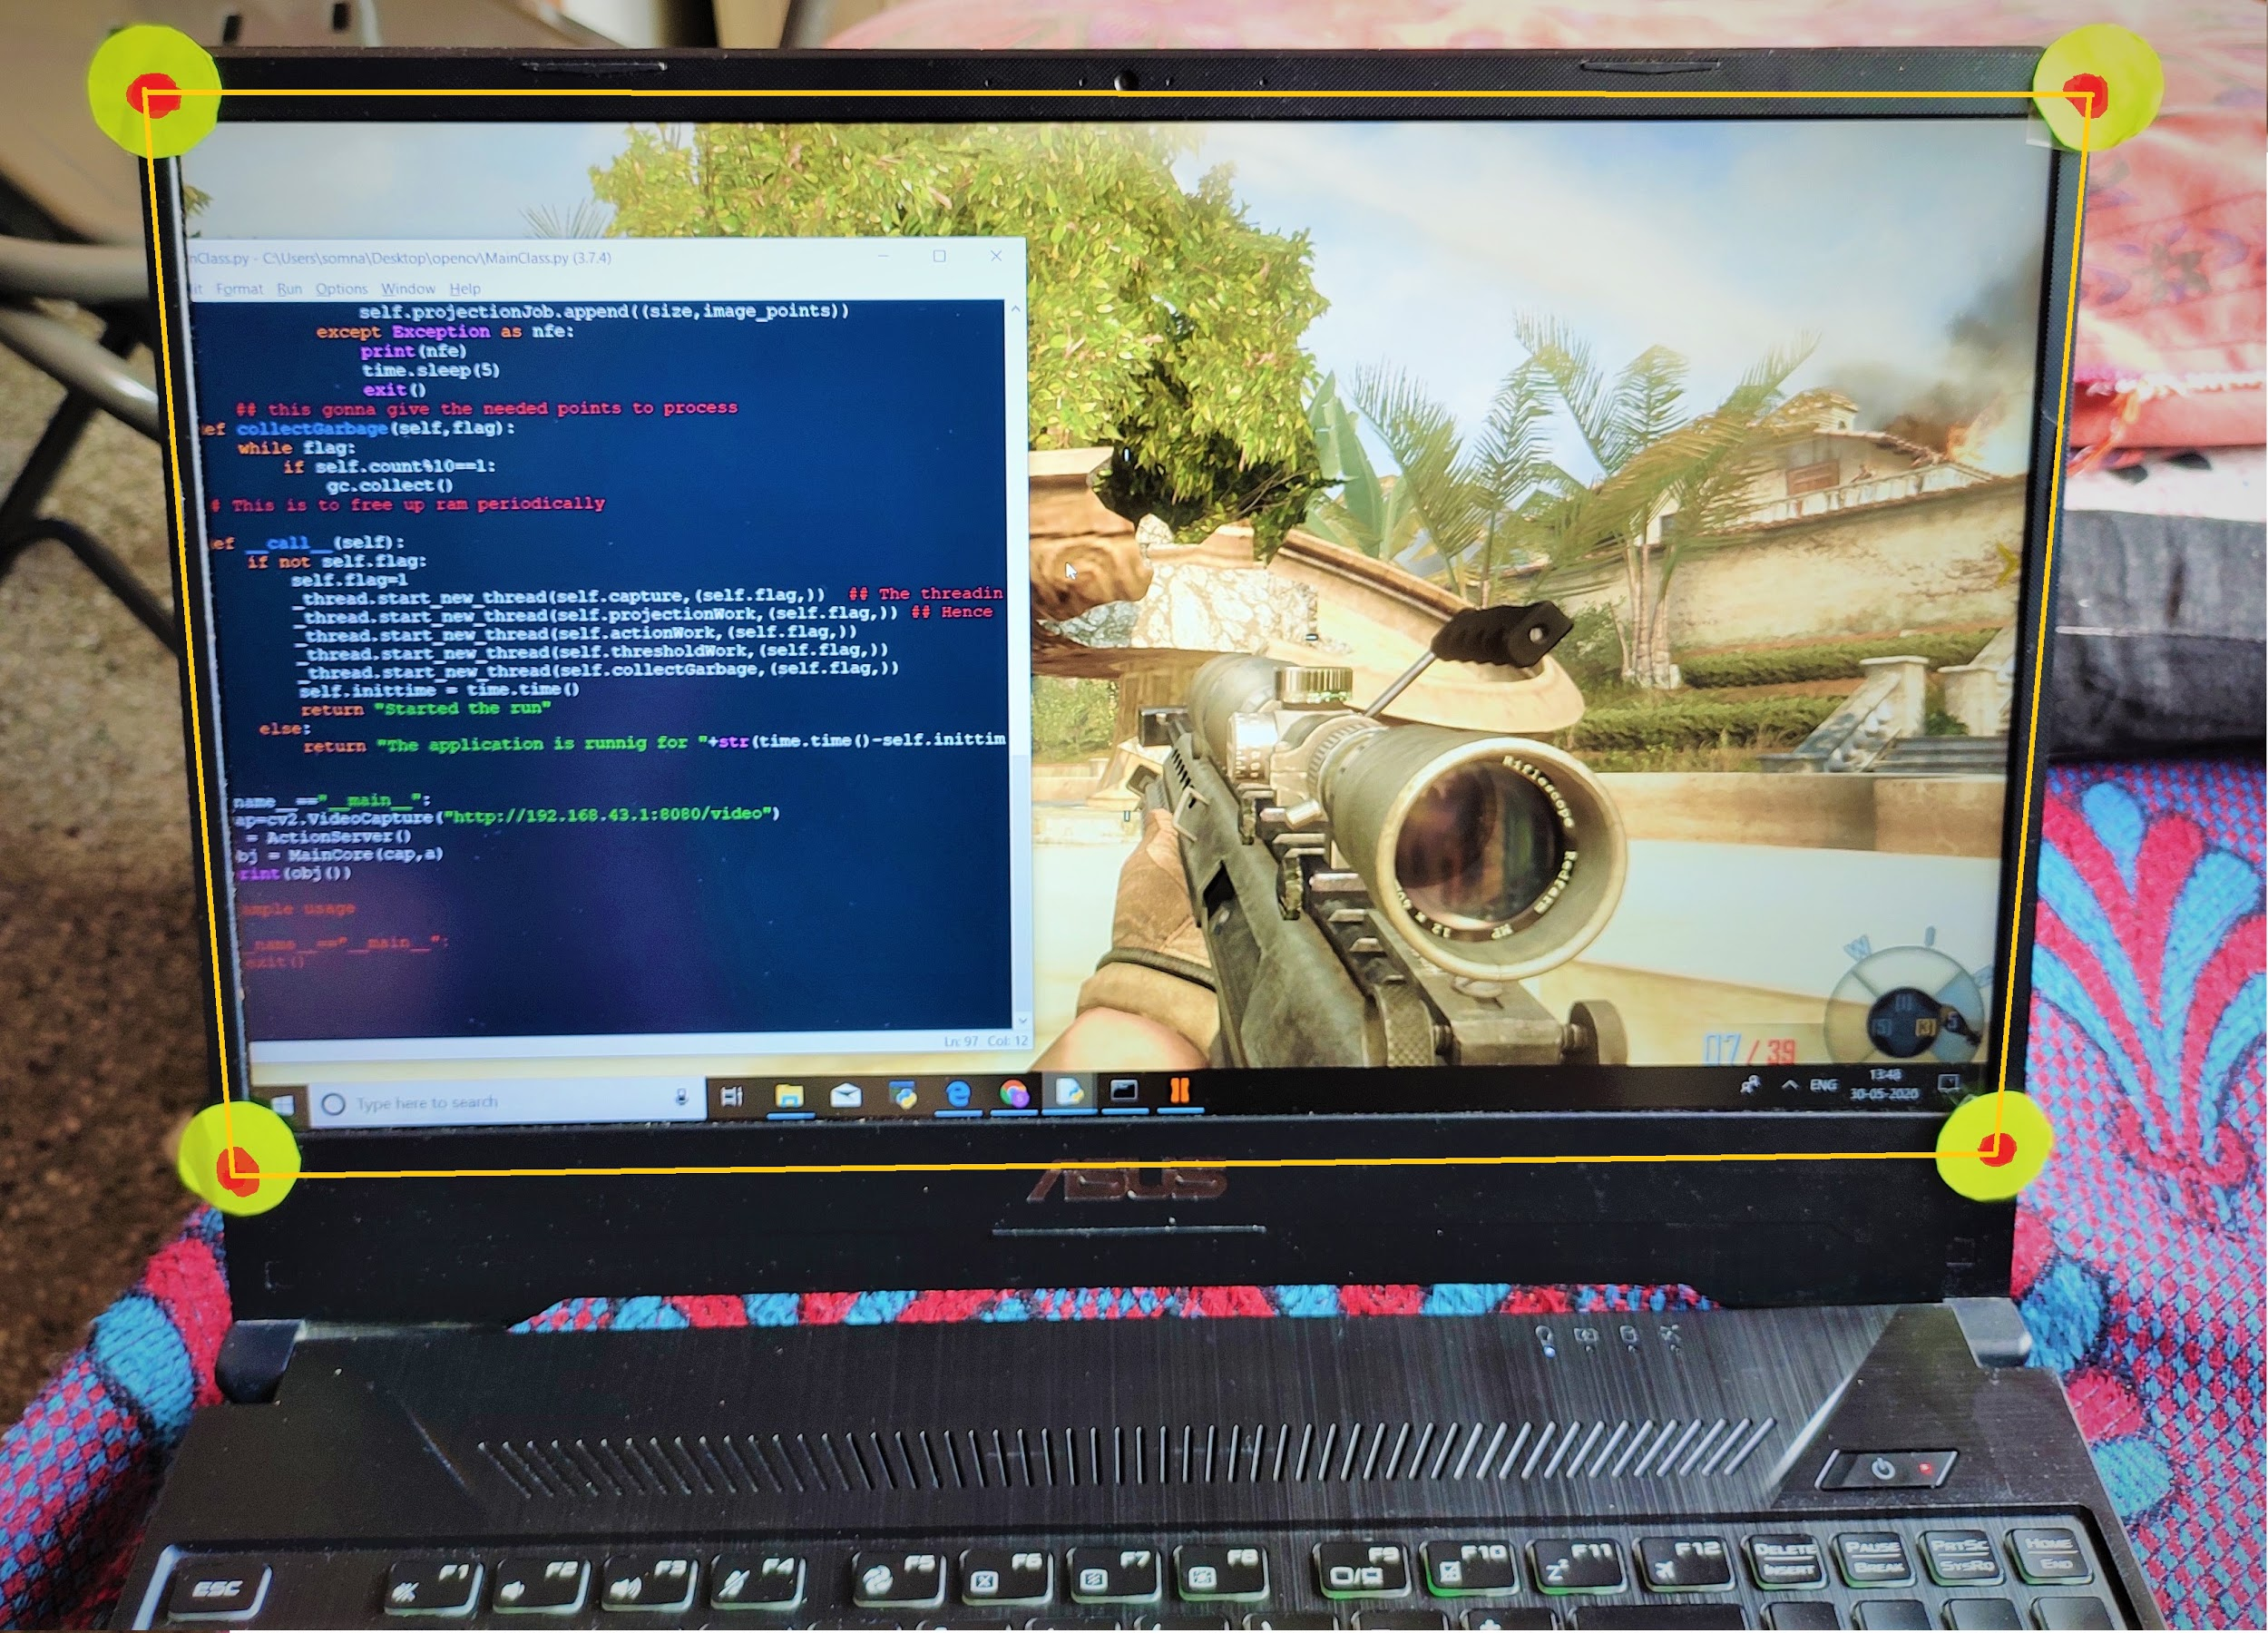
Implementations - Light Gun
So while learning computer vision this seemed like a simple figuring out the green vector to the right.
And then just making a mouse click at that point with respect to the resolution and dimensions of the display.
For more updates. ..

Slide 14
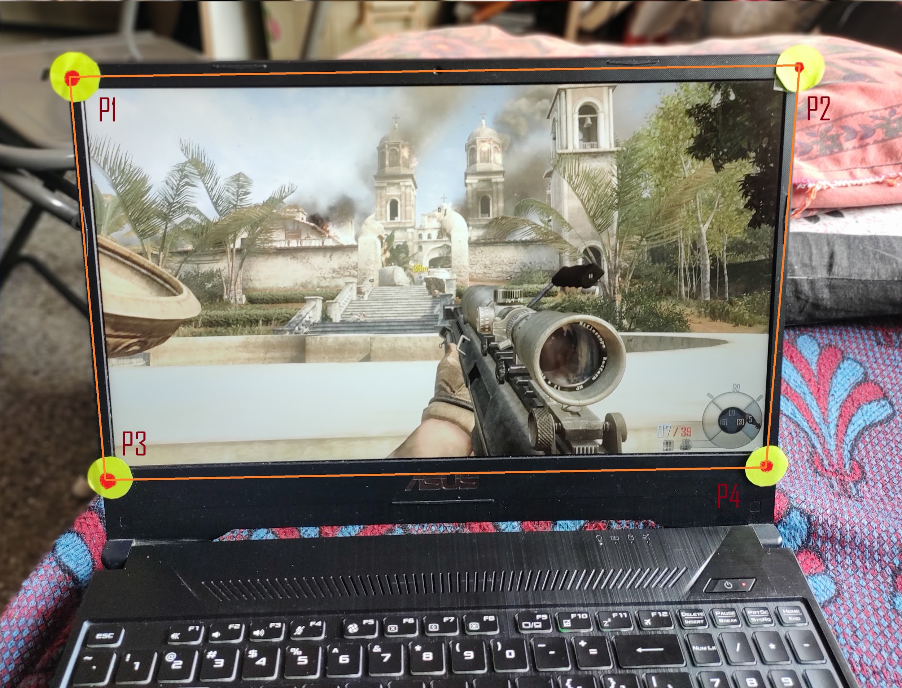
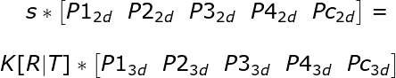
Implementations- Light Gun
Pc

Slide 15
Implementations-Depth Maps
Back in the JEE days we used to cross check our answers.
Are the given data
Where,
Feedback to the function for its accuracy, can be also in form of its gradient.
Real world constraint the the solution should follow to be an acceptable approximation.

Slide 16
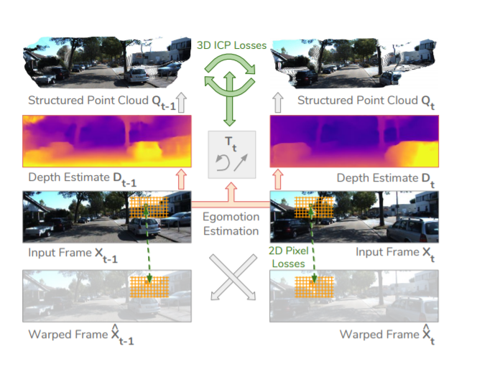
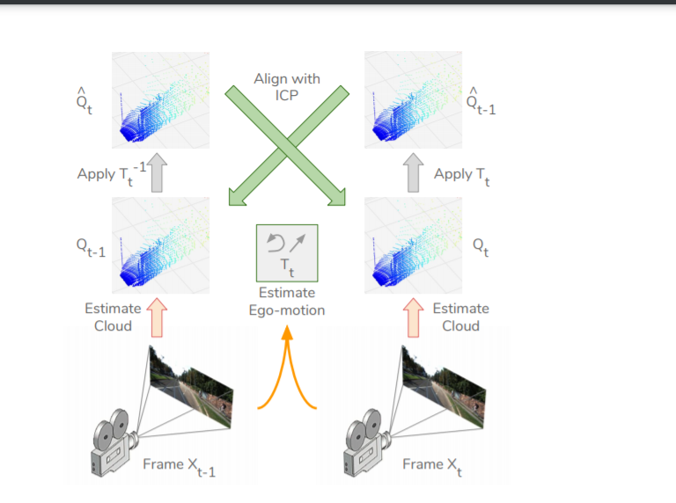
Implementations - Depth Maps
So here is the basic principle of this method. Paper is here. Real beauty of the paper is in the way it is able to formulate 3d constraint into a function which is differentiable. Site for the same.

Slide 17
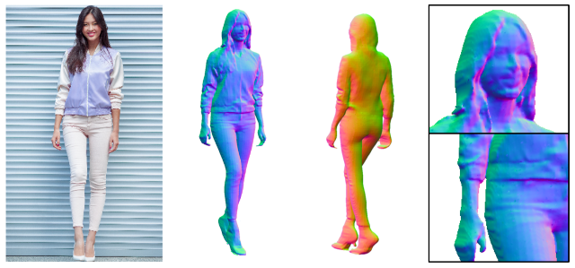
Implementations - 3D human models
Based on PIFu Pixel-Aligned Implicit Function. This is also based on 3D constrained of the system. Paper is here.

Slide 18
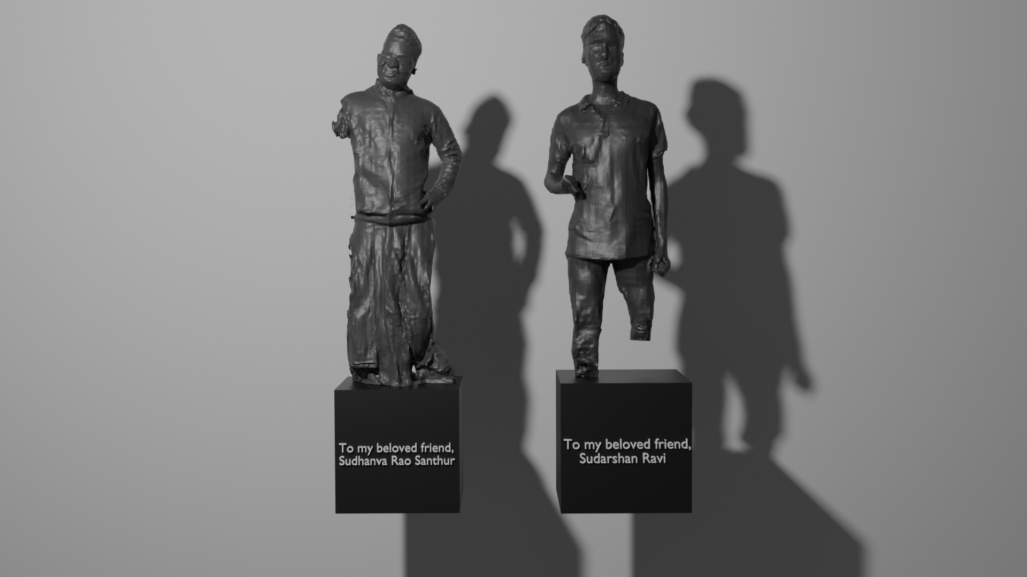
My Try at it. : )

Slide 19
Furthermore : -
Nothing actually i believe with enough theory you will be able to understand papers related to these topics with ease.
Do let me know if you are facing any problem a given concept.

Slide 20
THANK YOU

